Slide 1
Technology Infrastructure
Lesson 9

Slide 2
Career Paths
Differentiate front end vs backend.
Duration : 3.5 Hours
Period : Week1 Day 5

Slide 3
Learning Outcomes:
By the end of the lesson, students ,must be able to:
Explain the concepts of bootcamp
Understand how bootcamp operate and their position within skill shortage and mismatch in South Africa
Notes:
Tip: Add your own speaker notes here.

Slide 4
Introduction
You are aware that technology keeps improving month in month out to the point that learners enrolled at colleges and universities may end up learning technologies which are no longer widely supported by industries.
By this, we mean that, mainstream tertiary institutions take longer to produce graduates who can be absorbed by the market. A possible solution could be bootcamps
Notes:
Tip: Add your own speaker notes here.

Slide 5
So what is a bootcamp?
Bootcamps are schools where you learn to code full-time - usually in person.
The goal of a bootcamp is to take a classroom full of people who have never worked in tech before and help them get their first developer job.
Success of bootcamps is largely dependent on the teaching staff, placement officers and how are they regulated?
Notes:
Bootcamp is at its infancy in South Africa geared towards meeting demand from the labour market.
It is a direct challenge to the academic mainstream.

Slide 6
Accreditation of bootcamps
Most programs are accredited and registered with SAQA and quality assured for the purposes of horizontal and vertical articulation. Is it necessary?
Our bootcamp is not accredited but largely influenced by your future employers.
Notes:
But there's a growing transparency movement within bootcamps.
Some bootcamps want to self-regulate the industry before the government is forced to step in and regulate it for them.

Slide 7
Timelines for the course
The course duration is one year split in to two parts:
Six months tuition (face-to-face)
Six months –industrial attachment/internship.
Notes:
Research has shown that graduates from academic mainstream lacked significant practical internship with majority of their experience done in simulated environment.
So at Lifechoices, our curriculum is designed to respond directly to the market. We even included suggestions from different companies which are our partners.
We run the academy like a social enterprise aiming to be self-sustainable in few years time. We empower young people to change their lives, tying our success to theirs (https://lifechoicesacademy.com/about-salesian-life-choices/)

Slide 8
Six months Tuition
You are expected to attend lectures (not optional)
Being punctual, present and respectful
You will do two major subjects and prepare a portfolio of evidence.
POE will be shared with prospective employers.
Building the POE must be a continuous process.
No POE- no internship (Due first two weeks of month6)
Fees - You are encouraged to contribute to the organization once you start working as a sign of appreciation on the value from the course.
There are optional subjects after submission of the Portfolios.
Notes:
You will be asked to register on Snapscan for your contributions. You can get a tax certificate for SARS filling

Slide 9
Structure of our boot camp
Coding bootcamp
Web Design
(200 hrs)
Software
Development
(200 hrs)
HTML
CSS
JavaScript
Python
Django
MySQL
Notes:
There are two major subjects i.e. Web design and Software development. The Web design covers our Front End development while the Software development covers our Back End development. With regards to frameworks, REACTJS is used for Front End while Django is used for Back End.

Slide 10
Final project (POE): expected.
HTML, CSS and JavaScript
Python MySQL
Frameworks- REACTJS, DJANGO
Notes:
The key difference between a library and a framework is "Inversion of Control". When you call a method from a library, you are in control. But with a framework, the control is inverted: the framework calls you.
When you use a library, you are in charge of the flow of the application. You are choosing when and where to call the library. When you use a framework, th
e framework is in charge of the flow. It provides some places for you to plug in your code, but it calls the code you plugged in as needed.

Slide 11
Portfolio of Evidence
You are expected to develop a web based application (e-commerce, CRM, social media e.t.c).
Examples includes airline reservation, online bookstore, CRM systems, social media systems, Health systems and others.
Portfolios must be UNIQUE
Expected: login , forms, navigation, DB Management, theming, cart or ticketing, documentation.
You can do more than the required.

Slide 12
Lets have a look
https://www.smashingmagazine.com/2013/06/workflow-design-develop-modern-portfolio-website/
Notes:
See how a portfolio looks like.

Slide 13
Six months internship
The company will place you at a company for a six month period.
You are expected to perform to your best ability.
History have shown us that some end up being employed at the very companies.
However, the company is not obligated to give you a permanent job after the internship.
While you are at the organization, you are not only expected to follow also the company rules but Lifechoices rules as well.
Certification after successful completion of internship
Notes:
It is your duty to perform to the best of your ability. Past experiences have shown that some companies end up employing their interns on a full time basis. So it depends on your work etiquette.

Slide 14
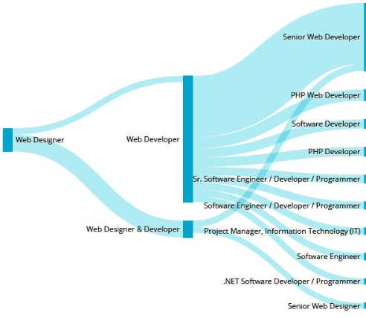
Possible carrier paths
Notes:
So, have you decided which route you want to take? You can also consider broad roles such as Frontend developer, Backend developer, Fullstack developer, Quality testers, Project leaders, data scientist and many others

Slide 15
Contributions/ Suggestions/thoughts
?
Notes:
What is your take on Lifechoices initiative towards upskilling of youth?

Slide 16
References
Thayer, K., & Ko, A. J. (2017, August). Barriers faced by coding bootcamp students. In Proceedings of the 2017 ACM Conference on International Computing Education Research (pp. 245-253).

